Slide 1
CPE 221: Computer Organization
06 ARM Memory, Indexing, and Function Calls
rahul.bhadani@uah.edu

Slide 2
Announcement
Exam 1: February 19, 2025, Wednesday: 4:20 PM - 5:40 PM
1 Page, One-sided , Handwritten Sheet Allowed
Calculator Allowed
Close Notes, Close Books
May ask to write ARM Programming
Convert C Code to ARM Code
Will cover topics: Number Systems, 2s complements Floating Points, Digital Logic, Register-Transfer Language, Transistor/Gate Basics, K-map Minimization, Truth Tables, ARM Instructions, Questions on Disassembly and Memory Map of ARM Programs

Slide 3
Pseudo Instructions
LDR R3, [R0, R2] @ R3 = scores[i]
LDR is a pseudo-instruction.
These are simple assembly language instructions that do not have a direct machine language equivalent.
During assembly, the assembler translates each pseudo-instruction into one or more machine language
instructions.
The ARM assembler supports a number of pseudo-instructions that are translated into the appropriate combination of ARM instructions at assembly time.

Slide 4
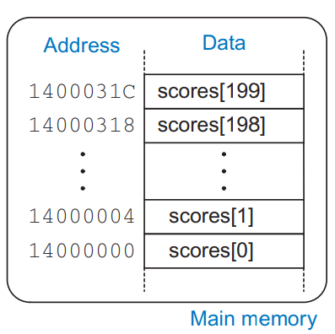
Memory
scores[200]
200 = length
index

Slide 5
Scaling Index in ARM
ARM can scale (multiply) the index, add it to the base address, and load from memory in a single instruction.
LDR R3, [R0, R1, LSL #2]
R1 is scaled (by using shift operation; shift left by two), then added to the base address (R0), and thus the memory address is R0 + (R1 x 4).

Slide 6
Indexing in ARM: Three Types
ARM also provides offset, pre-indexed, and post-indexed addressing to enable dense and efficient code for array accesses and function calls.

Slide 7
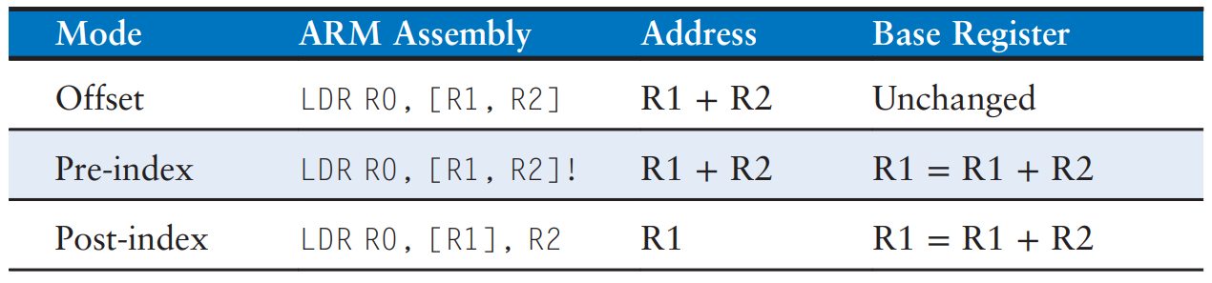
Indexing in ARM …
[Rn, #offset]
Offset addressing calculates the address as the base register ± the offset; the base register is unchanged.

Slide 8
Indexing in ARM …
[Rn, #offset]!
Pre-indexed addressing calculates the address as the base register ± the offset and updates the base register to this new address

Slide 9
Indexing in ARM …
[Rn], #offset
Post-indexed addressing calculates the address as the base register only and then, after accessing memory, the base register is updated to the base register ± the offset.

Slide 10

For loop using post-indexing
int i;
int scores[200];
...
for (i = 0; i < 200; i = i + 1)
scores[i] = scores[i] + 10;
@ R0 = array base address
@ initialization code …
LDR R3, =baseaddr
LDR R0, [R3] @ R0 contains base address
ADD R1, R0, #800 @ R1 = base address + (200*4)
LOOP
CMP R0, R1 @ reached end of array?
BGE L3 @ if yes, exit loop
LDR R2, [R0] @ R2 = scores[i]
ADD R2, R2, #10 @ R2 = scores[i] + 10
STR R2, [R0], #4 @ scores[i] = scores[i] + 10
@ then R0 = R0 + 4
B LOOP @ repeat loop
L3
.data
baseaddr: .word 0x14000000
Post-indexing
no need to use
ADD for incrementing index

Slide 11
What does the Following do?
LDR R2, [R3, R4, LSL #2]

Slide 12
What does the Following do?
LDR R2, [R3, R4, LSL #2]
Offset is R4 shifted left by 2 (so *4), used to index an array of words.

Slide 13
What does the Following do?
STR R5, [R6, #-256]

Slide 14
What does the Following do?
STR R5, [R6, #-256]
Negative offset, storing to R6 - 256.

Slide 15
What does the Following do?
LDRB R7, [R8, R9]

Slide 16
What does the Following do?
LDRB R7, [R8, R9]
Byte load with register offset.

Slide 17
What does the Following do?
STR R2, [R3, R4, LSL #2]!

Slide 18
What does the Following do?
STR R2, [R3, R4, LSL #2]!
Pre-index: R3 = R3 + (R4 << 2), then store R2

Slide 19
What does the Following do?
LDRB R5, [R6, #-64]!

Slide 20
What does the Following do?
LDRB R5, [R6, #-64]!
Pre-index with negative offset: R6 = R6 -64, then load byte.

Slide 21
Bytes and Characters
[−128, 127] only need single bytes
American Standard Code for Information Interchange (ASCII): assigns each text character a unique byte value.
ARM provides load byte (LDRB), load signed byte (LDRSB), and store byte (STRB) to access individual bytes in memory.

Slide 22
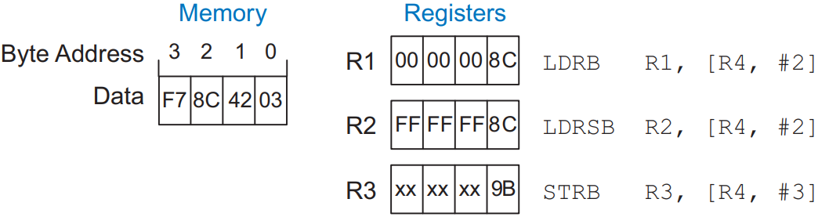
Accessing individual bytes
Leaves the rest of the bytes to be 0.
Leaves the rest of the bytes to be 1 (signed).
R4
Stores the the 0x9B into R4 at Byte 3
9B | 8C | 42 | 03

Slide 23
Operating on Strings
Array of characters – null terminated (0x00) in high-level languages.
“Hello!” = (0x 48 65 6C 6C 6F 21 00) stored in memory.
Null Character

Slide 24
Strings in ARM Assembly
// high-level code
// chararray[10] declared and
// initialized earlier
int i;
for (i = 0; i < 10; i = i + 1)
chararray[i] = chararray[i] − 32;
@ R0 = base address of chararray (initialized earlier), R1 = i
MOV R1, #0 @ i = 0
LOOP CMP R1, #10 @ i < 10 ?
BGE DONE @ if (i >=10), exit loop
LDRB R2, [R0, R1] @ R2 = mem[R0+R1] = chararray[i]
SUB R2, R2, #32 @ R2 = chararray[i] − 32
STRB R2, [R0, R1] @ chararray[i] = R2
ADD R1, R1, #1 @ i = i + 1
B LOOP @ repeat loop
DONE

Slide 25
Function Calls

Slide 26
Functions in ARM
In ARM, the caller (function that calls another function) conventionally places up to four arguments in registers R0–R3 before making the function call, and the callee (function that is called by another function) places the return value in register R0 before finishing.

Slide 27
Functions in ARM
By following this convention, both functions know where to find the arguments and return value, even if the caller and callee were written by different people.

Slide 28
Functions in ARM
The caller stores the return address in the link register LR at the same time it jumps to the callee using the branch and link instruction (BL). The callee must not overwrite any architectural state or memory that the caller is depending on.

Slide 29
Functions in ARM
The callee must not interfere with the behavior of the caller, i.e. the callee must know where to return to after it completes and it must not trample on any registers or memory needed by the caller.

Slide 30
Functions in ARM
The callee must not overwrite any architectural state or memory that caller is depending on.
The callee must leave the saved registers (R4–R11, and LR) and the stack, a portion of memory used for temporary variables, unmodified.

Slide 31
Branch-and-Link instruction (BL)
BL is used for calling a function.
ARM moves the link register to PC to return from a function using MOV PC, LR

Slide 32
A function call
Branch and Link Instruction: stores the return address of the next instruction in the link register, and branches to the target
int main() {
simple();
...
}
// void means the function returns no value
void simple() {
return;
}
0x00008000 MAIN ...
... ...
0x00008020 BL SIMPLE @ call the simple function
...
0x0000902C SIMPLE MOV PC, LR @ return
address to calling line
label of callee(address)

Slide 33
Example
diffofsums overwrote 3 registers:
diffofsums can use the stack to temporarily store registers
int main() {
int y;
...
y = diffofsums(2, 3, 4, 5);
...
}
int diffofsums(int f, int g, int h, int i) {
int result;
result = (f + g) − (h + i);
return result;
}
@ R4 = y
MAIN
...
MOV R0, #2 @ argument 0 = 2
MOV R1, #3 @ argument 1 = 3
MOV R2, #4 @ argument 2 = 4
MOV R3, #5 @ argument 3 = 5
BL DIFFOFSUMS @ call function
MOV R4, R0 @ y = returned value
...
@ R4 = result
DIFFOFSUMS
ADD R8, R0, R1 @ R8 = f + g
ADD R9, R2, R3 @ R9 = h + i
SUB R4, R8, R9 @ result = (f + g) − (h + i)
MOV R0, R4 @ put return value in R0
MOV PC, LR @ return to caller
We will revisit this code for improvement←later

Slide 34
Function with Multiple Parameters
.global _start
_start:
MOV R0, #2 @ First parameter
MOV R1, #3 @ Second parameter
BL add_numbers @ Call function
B _exit
add_numbers:
ADD R0, R0, R1 @ R0 = R0 + R1
MOV PC, LR @ Return
_exit:
MOV R7, #1

Slide 35
The Stack

Slide 36
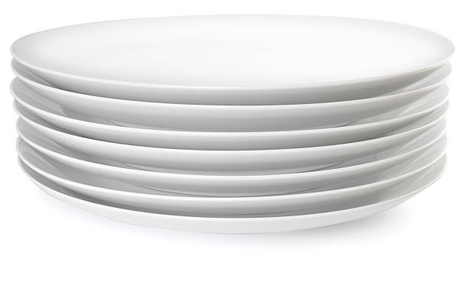
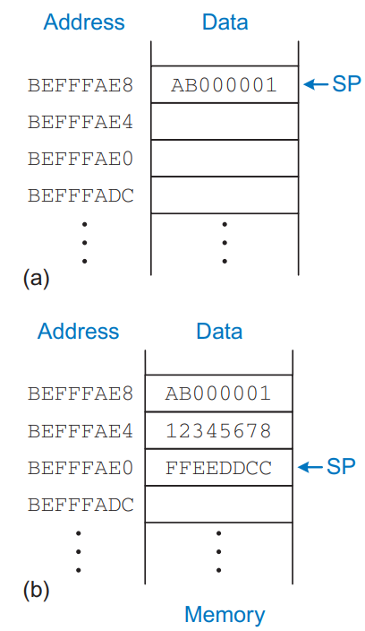
Stack
The stack is memory that is used to save information within a function.
Each function may allocate stack space to store local variables but must deallocate it before returning.
Like stack of dishes, last-in-first-out (LIFO) queue
Expands: uses more memory when more space needed
Contracts: uses less memory when the space no longer needed
The stack pointer, SP (R13), is an ordinary ARM register that, by convention, points to the top of the stack. A pointer is a fancy name for a memory address. SP points to (gives the address of) data.
The stack pointer (SP) starts at a high memory address and decrements to expand as needed.

Slide 37
Stack for functions
One of the important uses of the stack is to save and restore registers that are used by a function.

Slide 38
Stack for functions
A function should calculate a return value but have no other unintended side effects. In particular, it should not modify any registers besides R0, the one containing←the return value.

Slide 39
Stack for functions
The diffofsums function in Code Example 6.21 violates this rule because it modifies R4, R8, and R9. If main had been using these registers before the call to diffofsums, their contents would have been corrupted by the function call.

Slide 40
Stack for functions …
To solve the problems of registers to avoid unintended consequences:
A function saves registers on the stack before it modifies them, then restores them from the stack before it returns
Makes space on the stack to store the values of one or more registers
Stores the values of the registers on the stack
Executes the function using the registers
Restores the original values of the registers from the stack
Deallocates space on the stack

Slide 41
Improved code for function in ARM
@ R4 = result
DIFFOFSUMS
SUB SP, SP, #12 @ make space on stack for 3 registers
STR R9, [SP, #8] @ save R9 on stack
STR R8, [SP, #4] @ save R8 on stack
STR R4, [SP] @ save R4 on stack
ADD R8, R0, R1 @ R8 = f + g
ADD R9, R2, R3 @ R9 = h + i
SUB R4, R8, R9 @ result = (f + g) − (h + i)
MOV R0, R4 @ put return value in R0
LDR R4, [SP] @ restore R4 from stack
LDR R8, [SP, #4] @ restore R8 from stack
LDR R9, [SP, #8] @ restore R9 from stack
ADD SP, SP, #12 @ deallocate stack space
MOV PC, LR @ return to caller

Slide 42
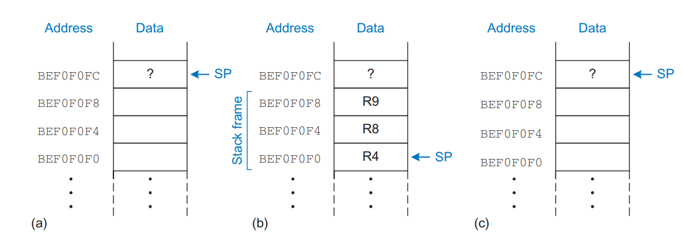
The stack: (a) before, (b) during, and (c) after the diffofsums function call

Slide 43
Loading and Storing Multiple Registers
Saving and restoring registers on the stack is such a common operation that ARM provides Load Multiple and Store Multiple instructions (LDM and STM) that are optimized to this purpose.

Slide 44
STMFD
STFD = Store Multiple Full Descending
Full means the fact that the memory address points to the location where the first register will be stored.
Descending refers to the stack grows downward in memory (i.e., the stack pointer decreases).

Slide 45
Example
STMFD SP!, {R4, R5, R6, LR}
The instruction stores the contents of registers R4, R5, R6, and the link register (LR) onto the stack.
The stack pointer (SP) is decremented by 16 bytes (4 registers × 4 bytes each).
After the operation, SP will point to the new top of the stack.

Slide 46
LDMFD
LDMFD = Load Multiple Full Descending
Load multiple registers from memory (typically the stack) in one operation.

Slide 47
Example
LDMFD SP!, {R4, R5, R6, LR}
This instruction loads the contents of the stack into registers R4, R5, R6, and the link register (LR).
The stack pointer (SP) is incremented by 16 bytes (4 registers × 4 bytes each).
After the operation, SP will point to the new top of the stack.

Slide 48
Loading and Storing Multiple Registers
@ R4 = result
DIFFOFSUMS
STMFD SP!, {R4, R8, R9} @ push R4/8/9 on full descending stack
ADD R8, R0, R1 @ R8 = f + g
ADD R9, R2, R3 @ R9 = h + i
SUB R4, R8, R9 @ result = (f + g) − (h + i)
MOV R0, R4 @ put return value in R0
LDMFD SP!, {R4, R8, R9} @ pop R4/8/9 off full descending stack
MOV PC, LR @ return to caller

Slide 49
Question
Which series of signals will multiply a number Y by 145?
R1 = Y,
A
R0←R1
R0←(R0 << 6)
R0←R0 + R1
R0←R0 + R1
R0←(R0 << 1
R0←R0 + R1
R0←R0 + R1
C
R0←R1
R0←(R1 << 4)
R0←R0 + R1
R0←(R0 << 1)
R0←R0 + R1
R0←R0 + R1
R0←R0 + R1
R0←(R0 << 2)
R0←R0 - R1
R0←R0 - R1
R0←R0 – R1
B
R0←R1
R0←(R0 << 4)
R0←R0 + R1
R0←R0 + R1
R0←R0 + R1
R0←(R0 << 2)

Slide 50
Stack Pointers
The location where the next (32 bit) piece of information will be stored is defined by the Stack Pointer (SP), or, the memory address stored in the SP register.
Functions take advantage of Stack for saving local variables, preserving register state, etc.
To keep everything organized, functions use Stack Frames, a localized memory portion within the stack which is dedicated for a specific function.
A stack frame gets created during the function creation. The Frame Pointer (FP) is set to the bottom of the stack frame and then stack buffer for the Stack Frame is allocated.

Slide 51
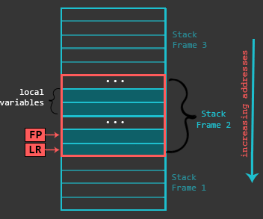
Frame Pointers
The stack frame (starting from its bottom) generally contains the return address (previous Link Register or LR), previous Frame Pointer, any registers that need to be preserved, function parameters (in case the function accepts more than 4), local variables, etc.
The actual contents of the Stack Frame may vary, the give example is one possible scenario. The Stack Frame gets destroyed when function execution finishes.

Slide 52
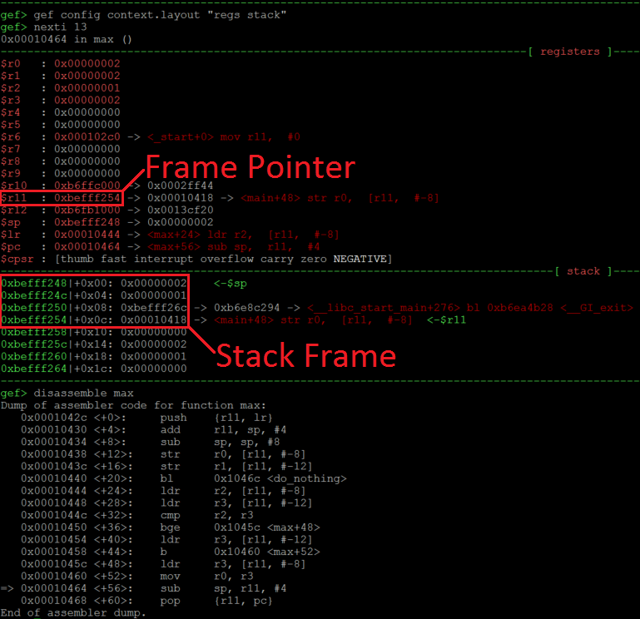
simple illustration of a Stack Frame through the perspective of GDB debugger.
int main() {
int res = 0;
int a = 1;
int b = 2;
res = max(a, b);
return res;
}
int max(int a,int b) {
do_nothing();
if(a<b) {
return b; }
else {
return a; }
}
int do_nothing() {
return 0;
}
In this situation, we are about to leave the function max (see the arrow in the disassembly at the bottom). At this state, the FP (R11) points to 0xbefff254 which is the bottom of our Stack Frame. This address on the Stack (green addresses) stores 0x00010418 which is the return address (previous Link Register). 4 bytes above this (at 0xbefff250) we have a value 0xbefff26c, which is the address of a previous Frame Pointer. The 0x1 and 0x2 at addresses 0xbefff24c and 0xbefff248 are local variables which were used during the execution of the function max. So the Stack Frame which we just analyzed had only LR, FP and two local variables.

Slide 53
Preserved vs Non-preserved Registers
If the calling function does not use registers that are saved and restored upon returning from the callee, the effort to save and restore them is wasted.
To avoid this waste, ARM divides registers into preserved (R0-R3, R12, SP, LR) and non-preserved categories.
A function must save and restore any of the preserved registers that it wishes to use, but it can change the nonpreserved registers freely.

Slide 54
Less number of preserved registers
Saves only R4 on the stack.
@ R4 = result
DIFFOFSUMS
PUSH {R4} @ save R4 on stack
ADD R1, R0, R1 @ R1 = f + g
ADD R3, R2, R3 @ R3 = h + i
SUB R4, R1, R3 @ result = (f + g) − (h + i)
MOV R0, R4 @ put return value in R0
POP {R4} @ pop R4 off stack
MOV PC, LR @ return to caller
The callee must save and restore any preserved registers that it wishes to use. The callee may change any of the non-preserved registers. Hence, if the caller is holding active data in a non-preserved register, the caller needs to save that non-preserved register before making the function call and then needs to restore it afterward. For these reasons, preserved registers are also called callee-save, and non-preserved registers are called caller-save.

Slide 55
Non-leaf Function Calls

Slide 56
Leaf and Non-leaf Functions
A function that does not call others is called a leaf function.
A function that does call others is called a non-leaf function.
Non-leaf functions may need to save non-preserved registers on the stack before they call another function and then restore those registers afterward.
Caller save rule: Before a function call, the caller must save any non-preserved registers (R0–R3 and R12) that it needs after the call. After the call, it must restore these registers before using them.
Callee save rule: Before a callee disturbs any of the preserved registers (R4–R11 and LR), it must save the registers. Before it returns, it must restore these registers.
A non-leaf function overwrites LR when it calls another function using BL. Thus, a non-leaf function must always save LR on its stack and restore it before returning.

Slide 57
Non-leaf Function Calls
int f1(int a, int b) {
int i, x;
x = (a + b)*(a − b);
for (i=0; i<a; i++)
x = x + f2(b+i);
return x;
}
int f2(int p) {
int r;
r = p + 5;
return r + p;
}
@ R0 = a, R1 = b, R4 = i, R5 = x
F1
PUSH {R4, R5, LR} @ save preserved registers used by f1
ADD R5, R0, R1 @ x = (a + b)
SUB R12, R0, R1 @ temp = (a − b)
MUL R5, R5, R12 @ x = x * temp = (a + b) * (a − b)
MOV R4, #0 @ i = 0
FOR
CMP R4, R0 @ i < a?
BGE RETURN @ no: exit loop
PUSH {R0, R1} @ save non-preserved registers
ADD R0, R1, R4 @ argument is b + i
BL F2 @ call f2(b+i)
ADD R5, R5, R0 @ x = x + f2(b+i)
POP {R0, R1} @ restore non-preserved registers
ADD R4, R4, #1 @ i++
B FOR @ continue for loop
RETURN
MOV R0, R5 @ return value is x
POP {R4, R5, LR} @ restore preserved registers
MOV PC, LR @ return from f1
@ R0 = p, R4 = r
F2
PUSH {R4} @ save preserved registers used by f2
ADD R4, R0, 5 @ r = p + 5
ADD R0, R4, R0 @ return value is r + p
POP {R4} @ restore preserved registers
MOV PC, LR @ return from f2
Non Leaf Function

Slide 58
Non-leaf vs Leaf Function
@/* A prologue of a non-leaf function */
PUSH {R11, LR} @/* Start of the prologue. Saving Frame Pointer and LR onto the stack */
ADD R11, SP, #0 @/* Setting up the bottom of the stack frame */
SUB SP, SP, #16 @/* End of the prologue. Allocating some buffer on the stack */
@/* A prologue of a leaf function */
PUSH {R11} @/* Start of the prologue. Saving Frame Pointer onto the stack */
ADD R11, SP, #0 @/* Setting up the bottom of the stack frame */
SUB SP, SP, #12 @/* End of the prologue. Allocating some buffer on the stack */

Slide 59
Recursive Function Calls
Calls itself
Non-leaf
Behave as both: calle and caller
Must save both: preserved and non-preserved registers

Slide 60
Recursion in ARM
int factorial(int n) {
if (n <= 1)
return 1;
else
return(n*factorial(n − 1));
}
@ push n and LR on stack
0x8500 FACTORIAL PUSH {R0, LR}
0x8504 CMP R0, #1 @ R0 <= 1?
0x8508 BGT ELSE @ no: branch to else
0x850C MOV R0, #1 @ otherwise, return 1
0x8510 ADD SP, SP, #8 @ restore SP
0x8514 MOV PC, LR @ return
0x8518 ELSE SUB R0, R0, #1 @ n = n − 1
0x851C BL FACTORIAL @ recursive call
0x8520 POP {R1, LR} @ pop n (into R1) and LR
0x8524 MUL R0, R1, R0 @ R0 = n*factorial(n − 1)
0x8528 MOV PC, LR @ return

Slide 61
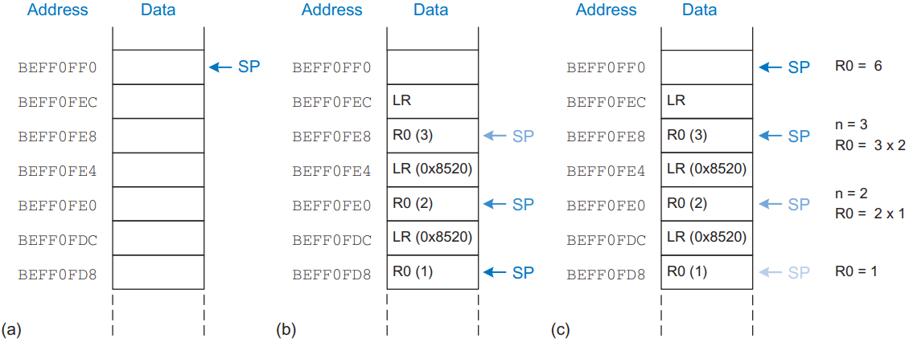
Stack during factorial(3) execution

Slide 62
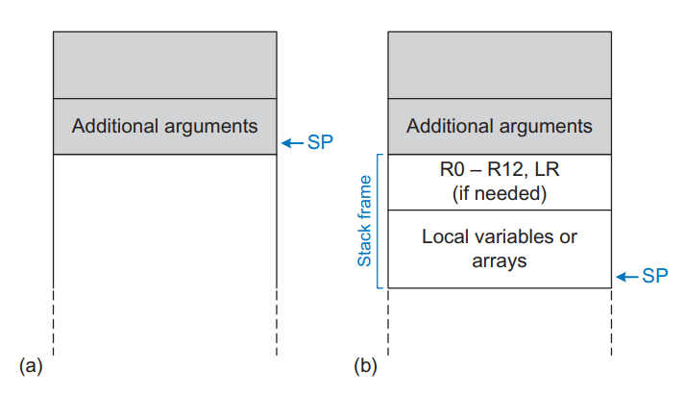
Functions with more than 4 arguments, too many local variables
If a function has more than four arguments, the first four are passed in the argument registers as usual. Additional arguments are passed on the stack, just above SP.
The caller must expand its stack to make room for the additional arguments.
Local variables are stored in R4–R11; if there are too many local variables, they can also be stored in the function’s stack frame.

